Slide 1
Code.org
17 FEB 2015

Slide 2
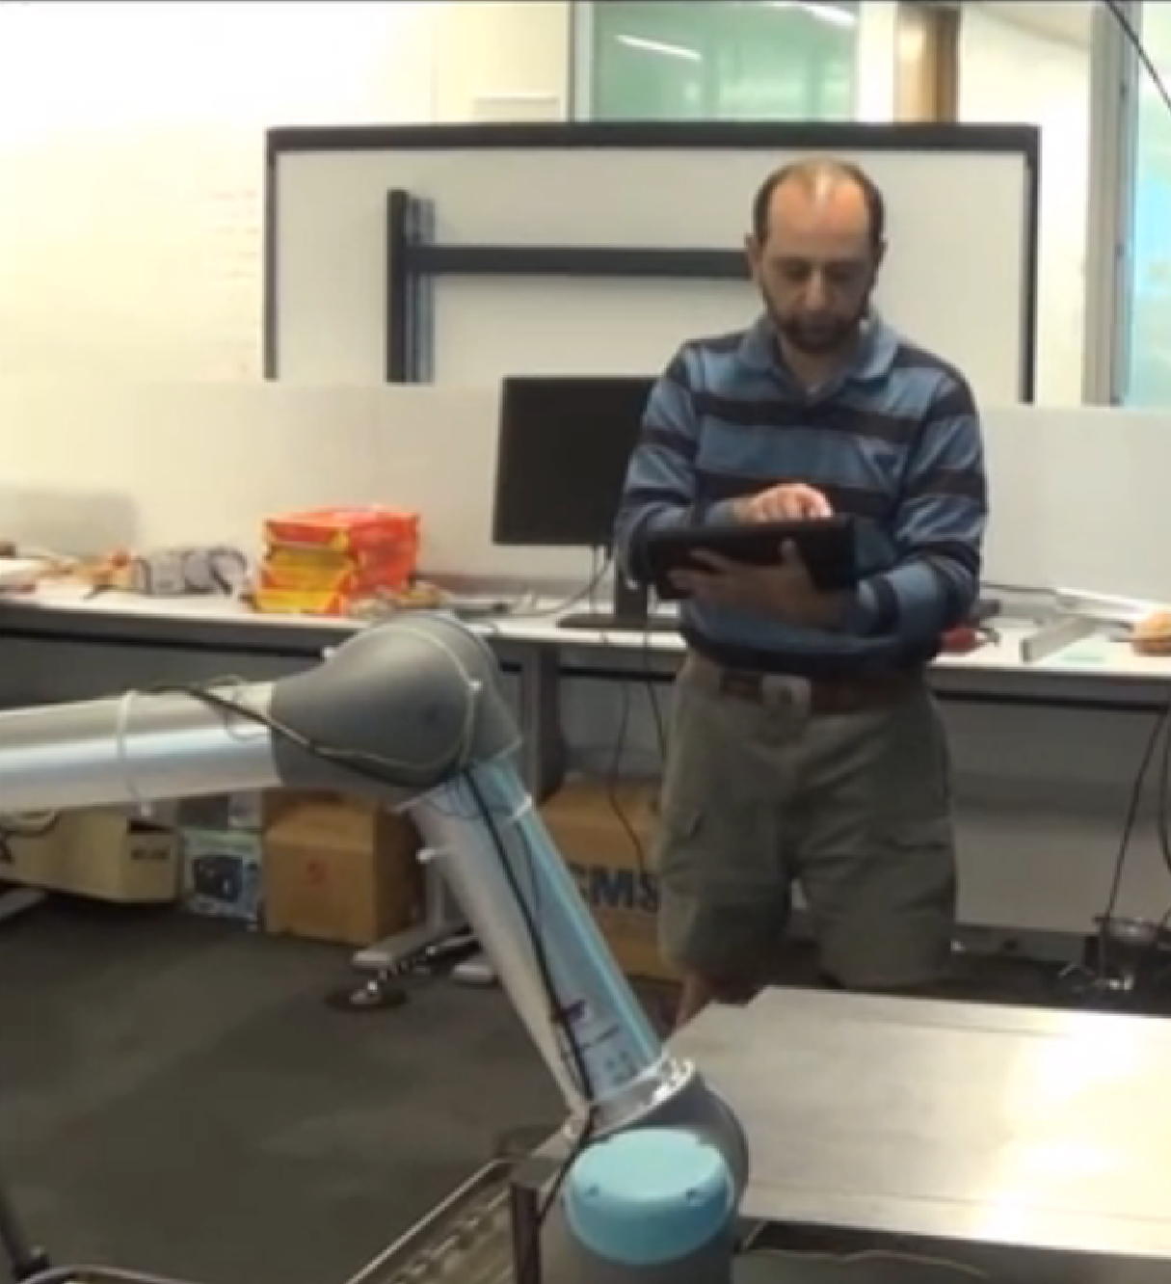
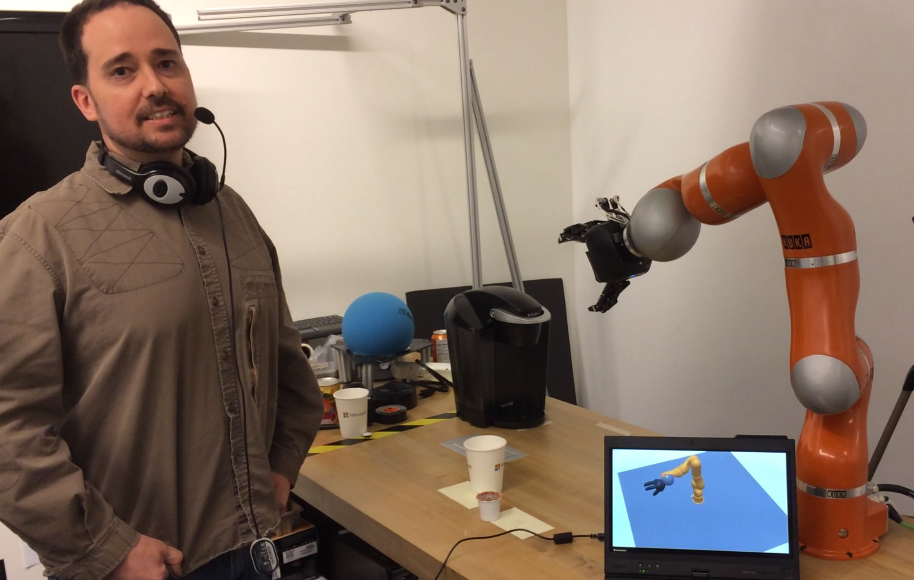
About Greg & Ashley
30+ years combined professional CS experience
20+ Microsoft
10+ Robotics, MSR
Breadth of Experience
Explored toys, hobbyist, multi-dimensional
Research, papers, conferences, …
Self employed now...
SelfieBot
SketchBot
...

Slide 3
About Code.org?
Vision?
Robotics?
CS or full STEM?
Community contribution?

Slide 4
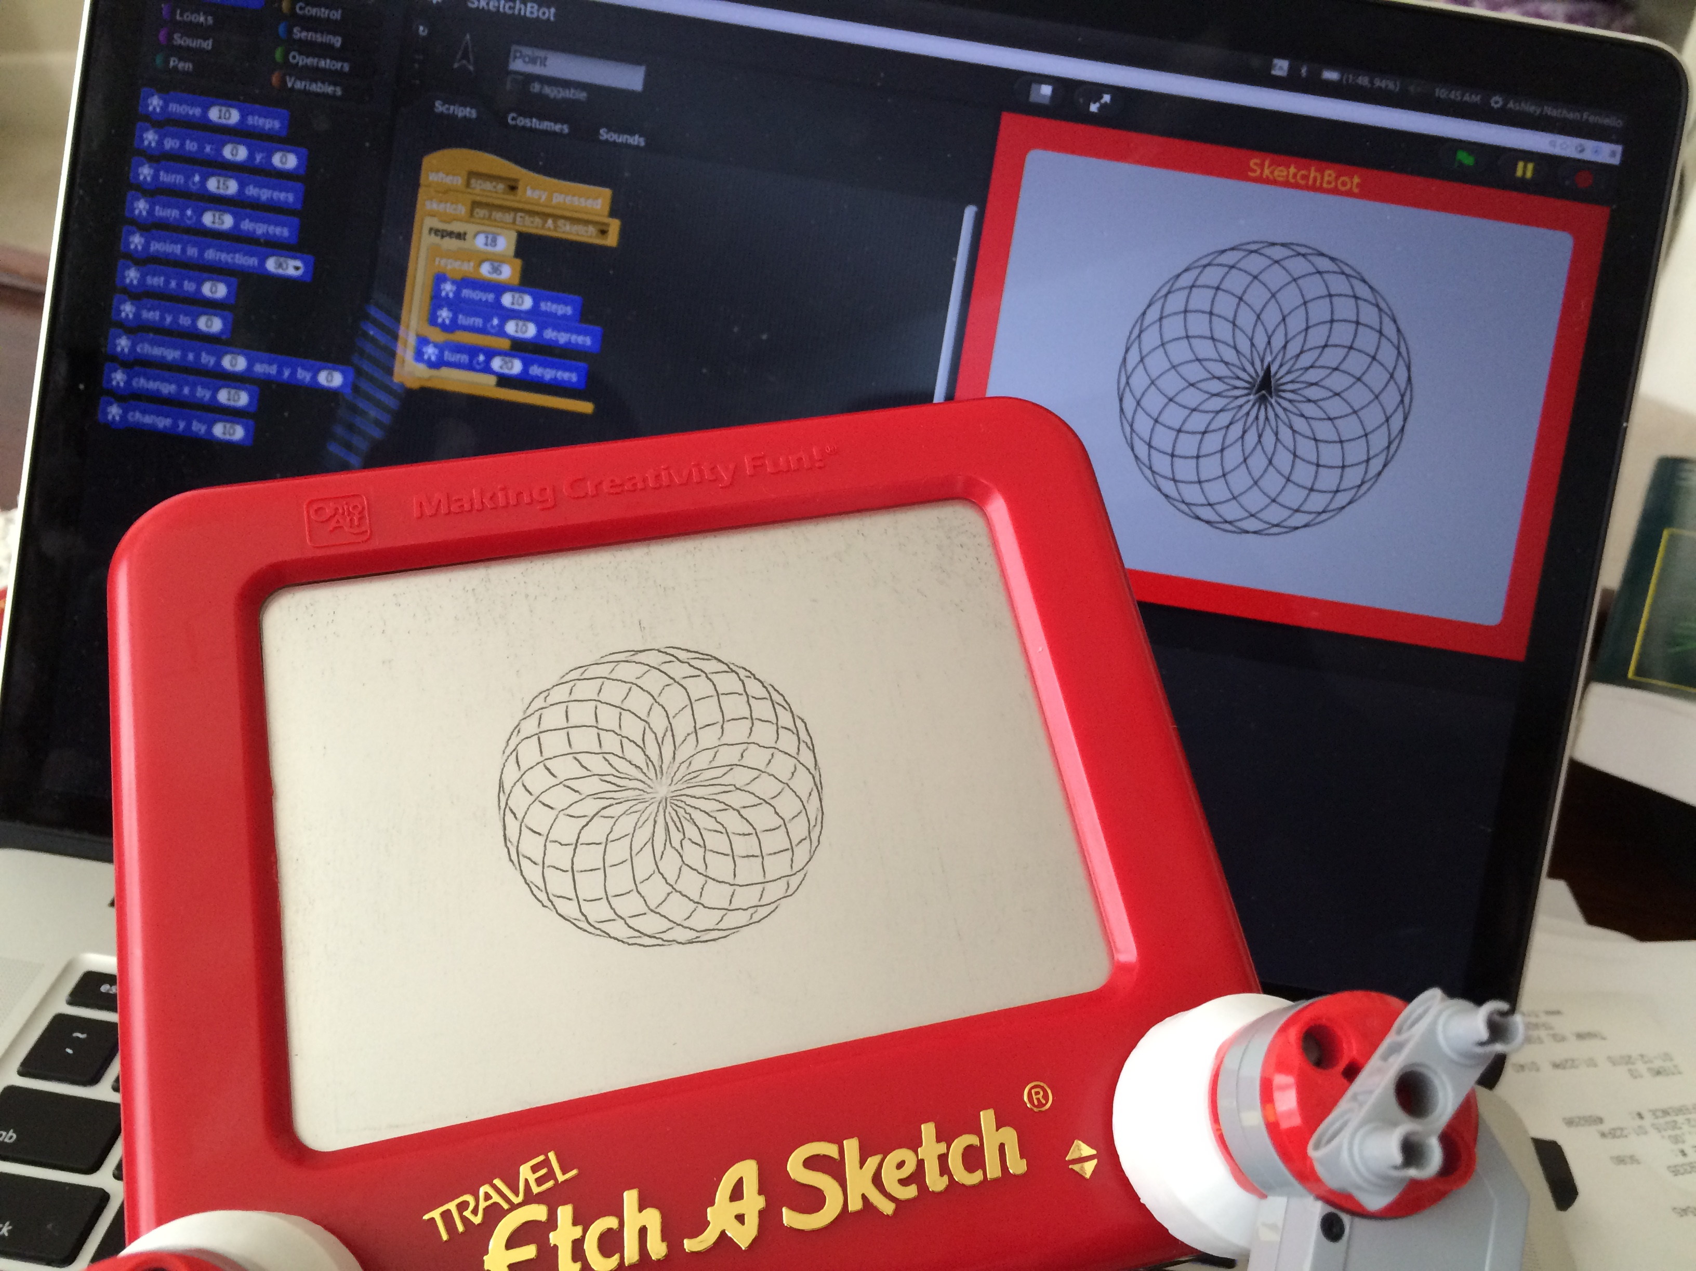
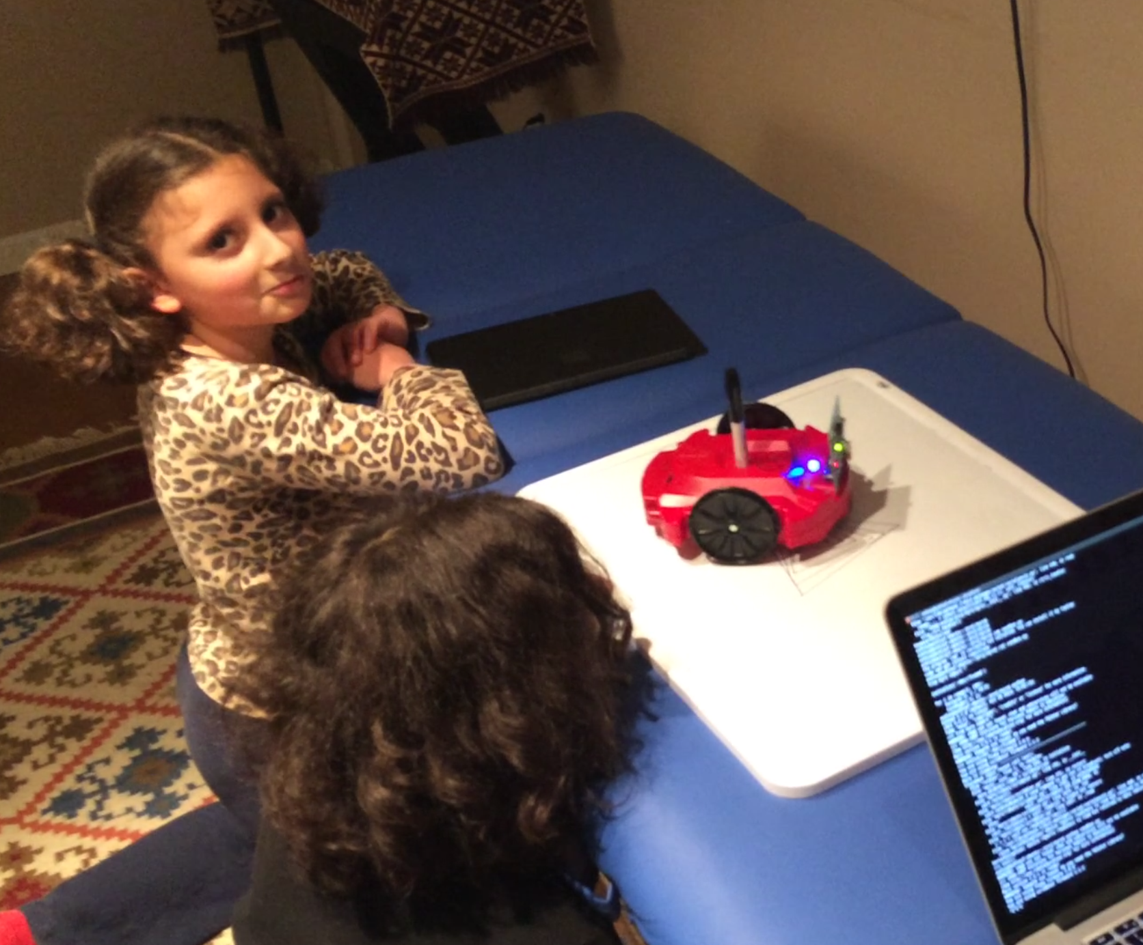
Teaching Robotics
CS
Simple: code.org
Intermediate: codeacademy (Python)
Serious: MIT Open Courseware, Corsera,
Robotics
Simple: Kibo (KinderLab) – trivial, what else
Intermediate: Lego, Scribbler (Python), …
Serious: Arduino, open ended (first real robotics)
We want to teach transferable skills earlier!
Imperfect sensors/actuators, physical constrains, ...
Simulation
Concurrency
Open/closed loop
SketchBot is 2 of 4 DOF vs. 3D printer

Slide 5
Why we're here?
We see a gap
“Robotics and science disguised as drawing”
Really control, physical system, ...
Could use Snap
SketchBot
Stumbled on this - Kickstarter
SketchBot (Scribbler, etc.)
Robotics to teach STEM
TechEd startup weekend (arm + STEM)

Slide 6
Demo
Hardware (Lego, 3D printed “hands”, ...)
Snap programming
Simulator
Connect real device and draw

Slide 7
Pitch
Hook SketchBot into code.org rather than Snap!
Open source controller (Lego NXT/EV3)
Open source the 3D model
Release DIY plans (steppers, MCU, …) - $10 BOM!
Provide curriculum
Spin up
Kickstart it ourselves? (tied to code.org)
Promoted by code.org

Slide 8
SketchBot

Slide 11
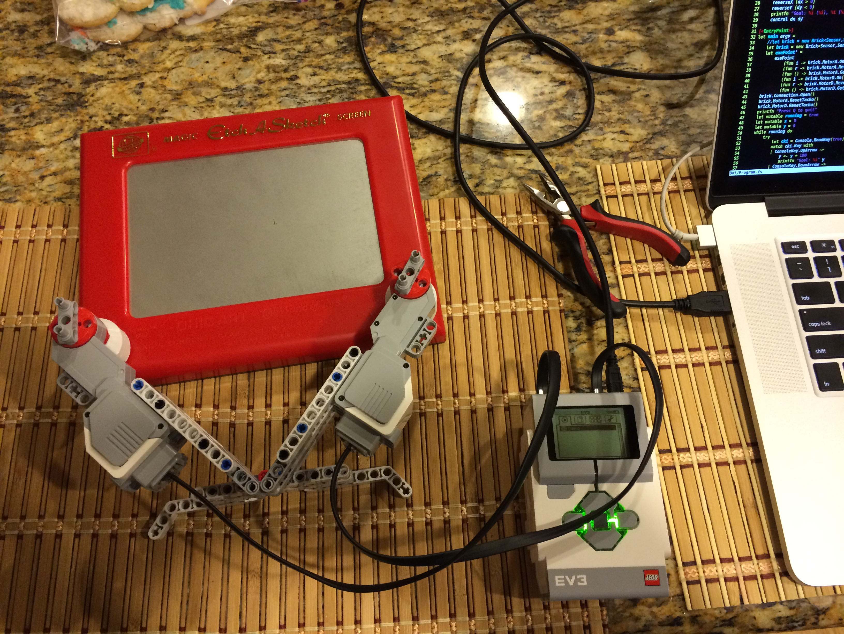

Slide 12
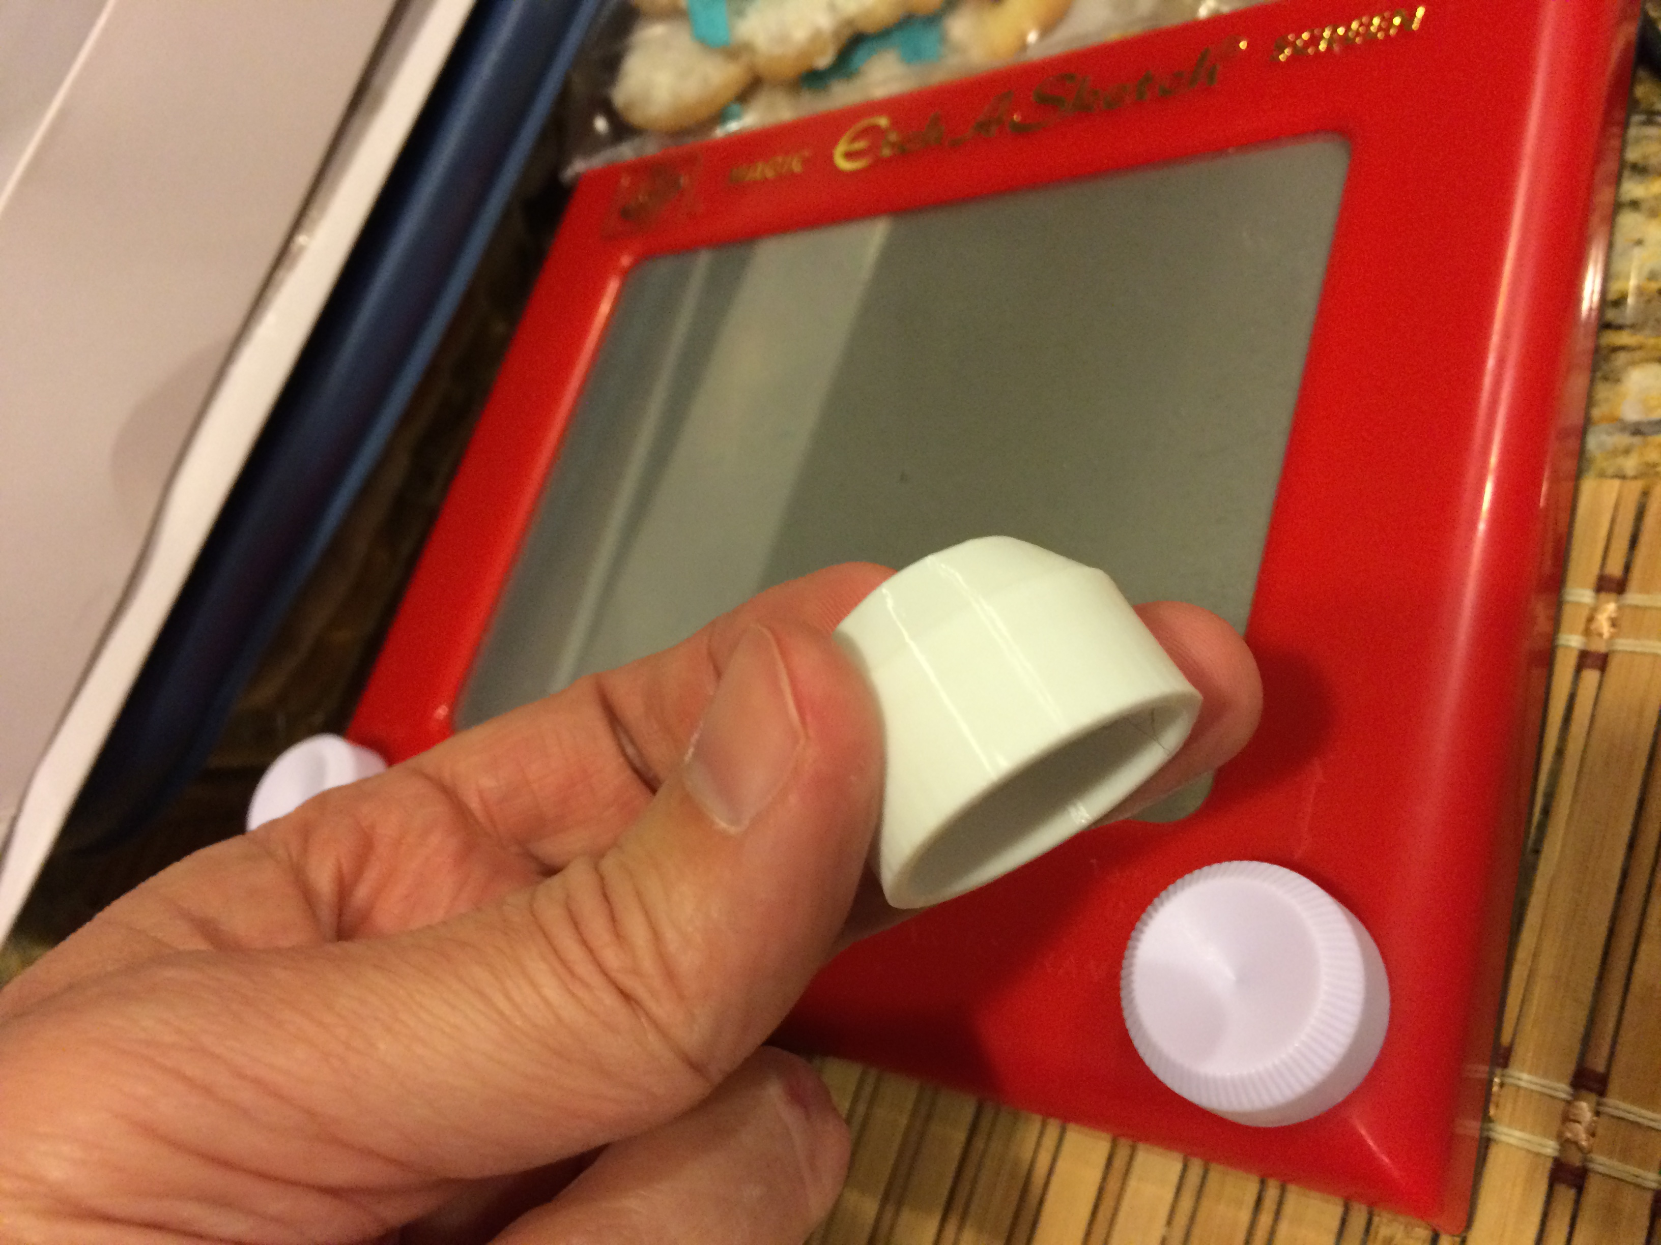

Slide 13
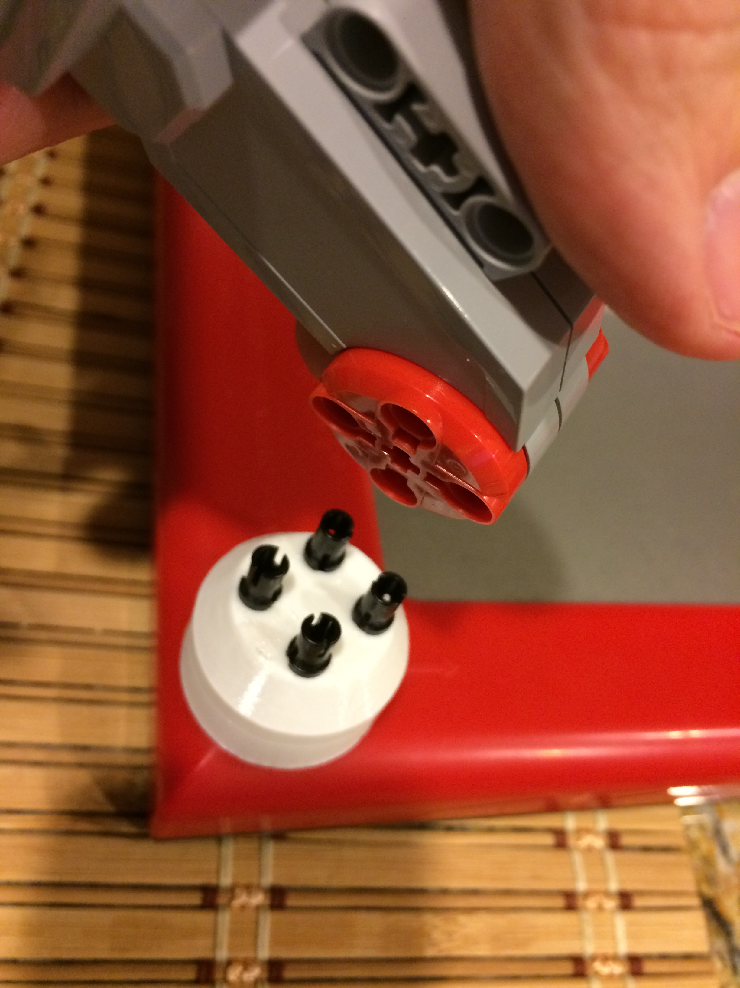

Slide 14
Scribbler

Slide 16
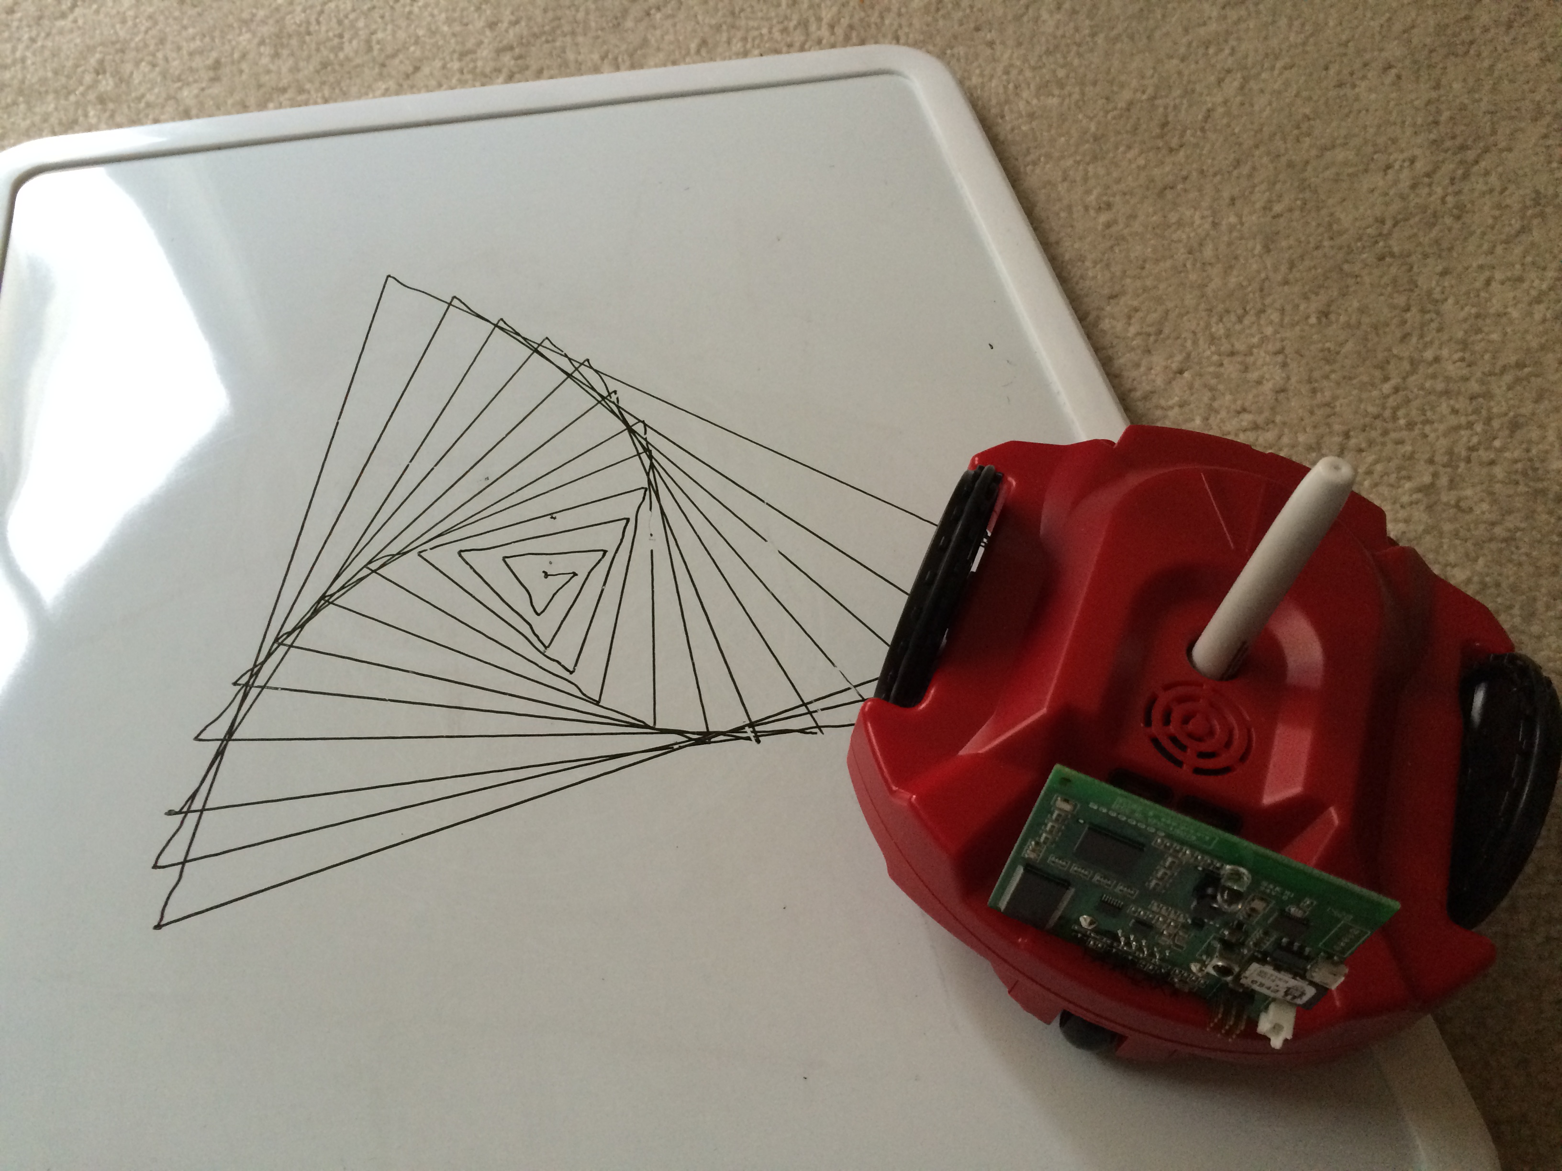

Slide 17
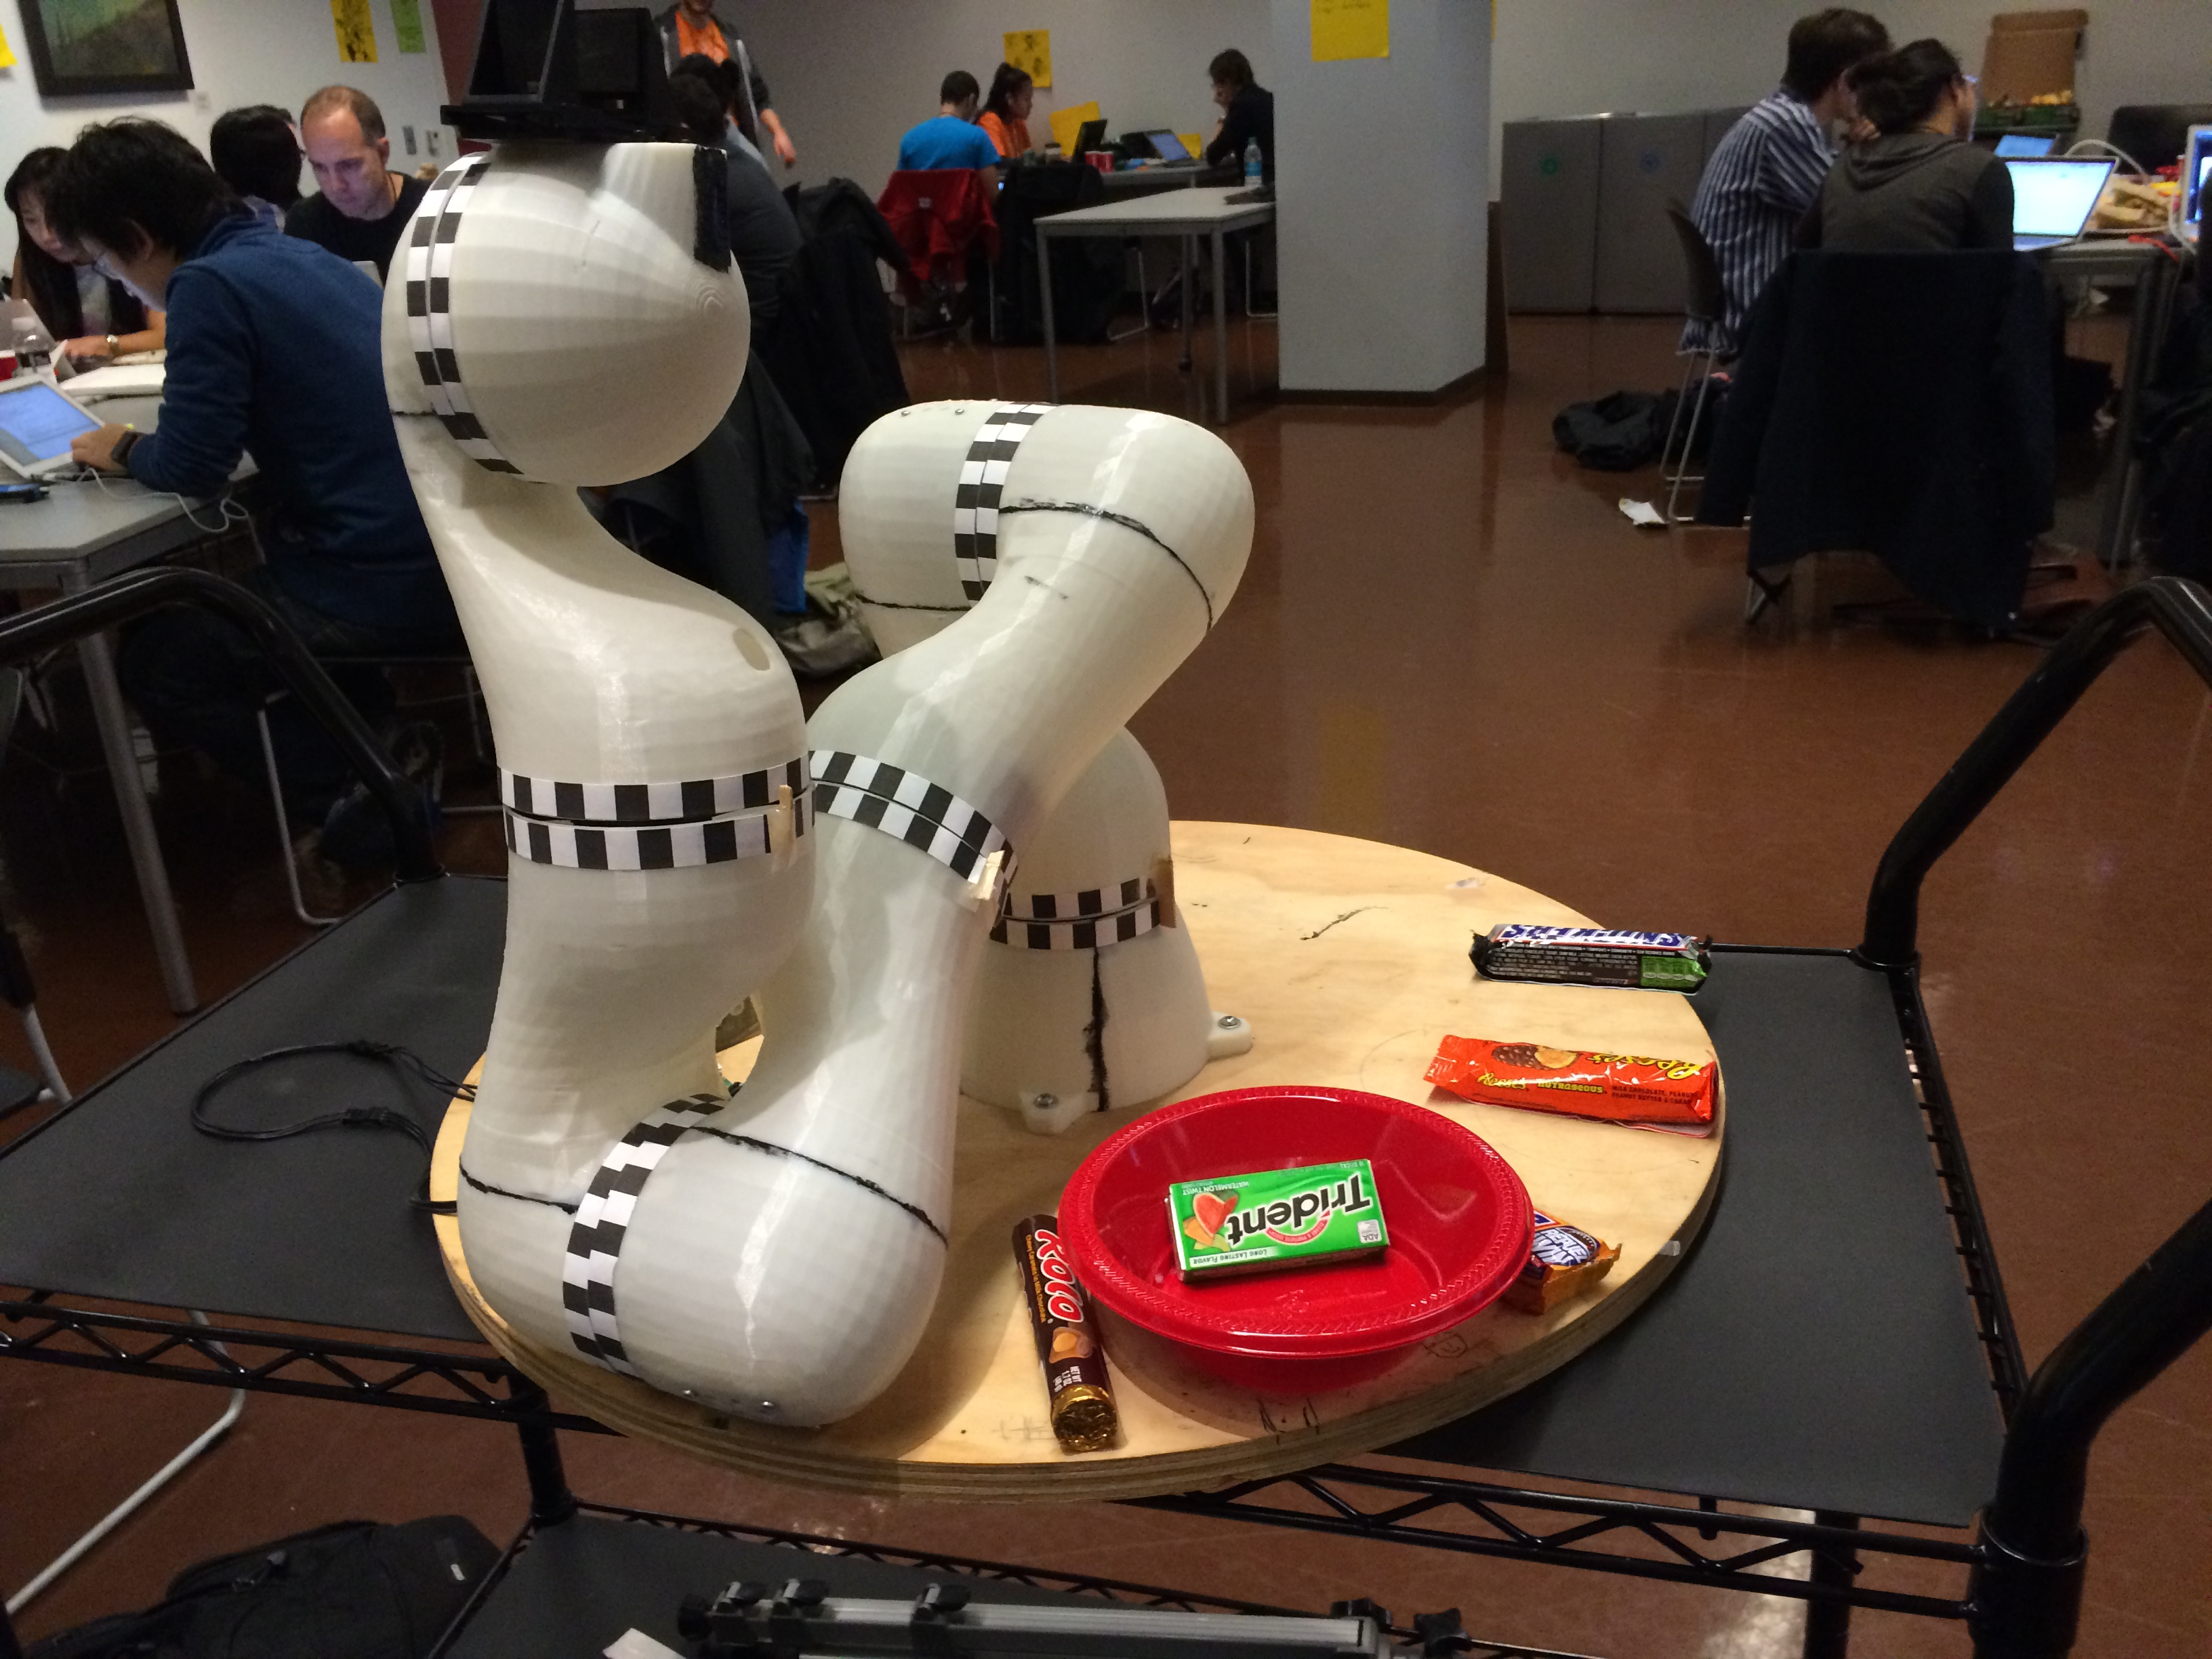
Project “Reach”

